Slide 1

Characterization of Quantum Computers for Optimal Quantum Machine Learning in Brain Tumor Classification
Sthefanie Passo
Ph.D. Candidate
1st author
Jeff Prevost
Ph.D Associate Professor
2nd author
Notes:
‹#›

Slide 2
Urgency:
~18k deaths/year (US)
[...] are brain tumors: 2nd leading cause of cancer death.
Classical ML struggles with MRI complexity
Quantum Potential:
QSVC: 98.5% accuracy (2D) vs. SVM: 94%
But: Results vary across IBM Eagle (e.g., ibm_brisbane vs ibm_kyiv) → Misdiagnosis risk
Notes:
‹#›

Slide 3
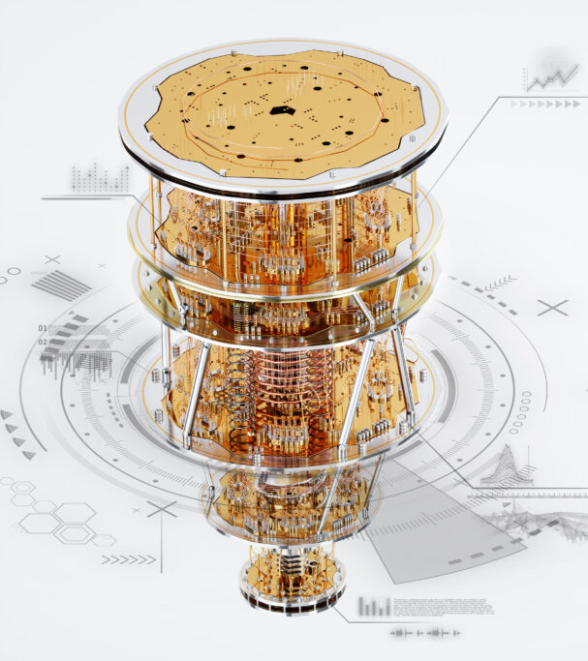
Quantum Computing Challenge
Problem: Hardware inconsistency → variable results on identical algorithms (e.g., IBM Eagle) Non-deterministic outcomes (vs. classical systems)
Key Gap: No framework for quantum reliability in real-world tasks (e.g., medical diagnostics)
Fig. 0.1: Quantum Computer Hardware Ilustration.

Slide 4
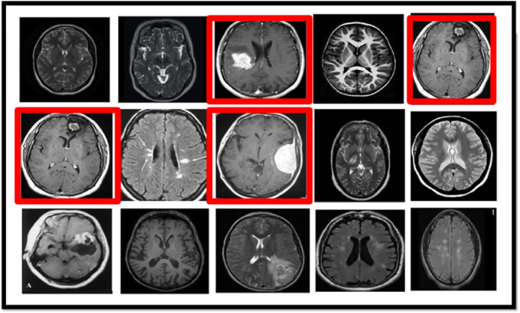
Motivation
Objective: Characterize quantum hardware for reliable QML in diagnostics
Hypothesis: Processors from the same architecture family (IBM Eagle) can achieve deterministic behavior in QSVM tasks, even with growing data complexity.
Impact: Enables trusted quantum adoption in clinical workflows
Fig. 0.2: MRI (Magnetic Resonance Imaging) Brain Tumor Classification.

Slide 5
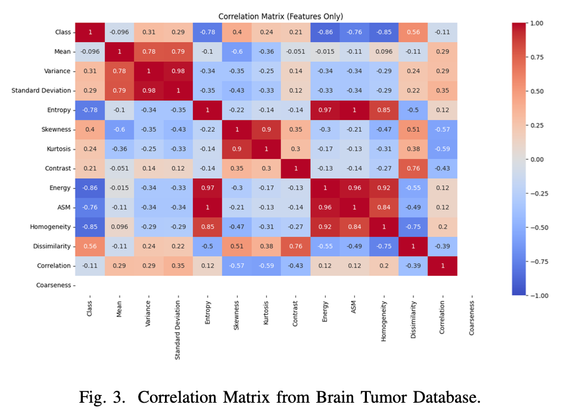

Brain Tumor Dataset
3,763 MRI samples → binary labels (tumor vs. normal)
15 statistical features: texture + intensity
Correlation analysis → 2D to 9D sub-datasets
Top features: Dissimilarity, Skewness
Kernel failure at 10D: IBM quantum timeout
80% train / 20% test

Slide 6
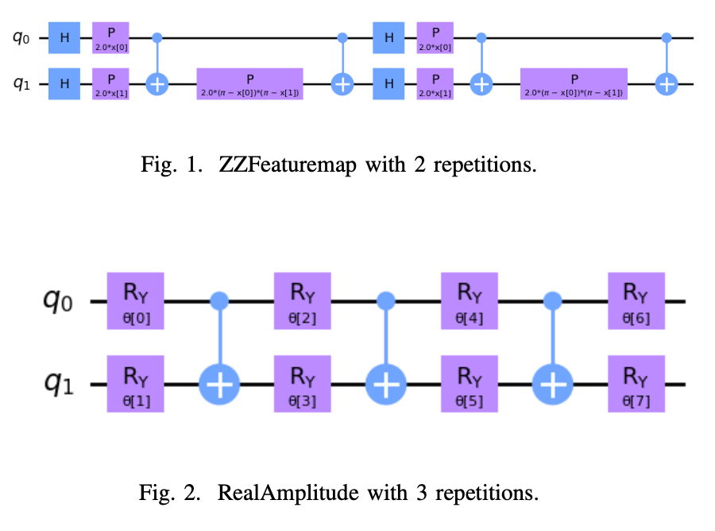
Quantum Data Encoding
Data Encoding: ZZFeatureMap & RealAmplitude mapped 10 features → entangled quantum states
Quantum Kernel: Processed encoded data
Feature Extraction: SVC & QSVC utilized

Slide 7
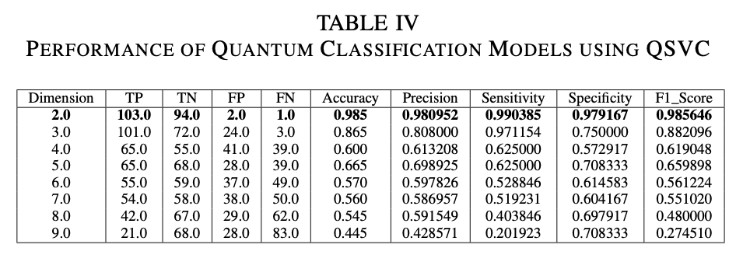
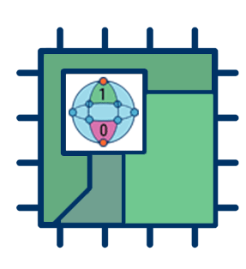
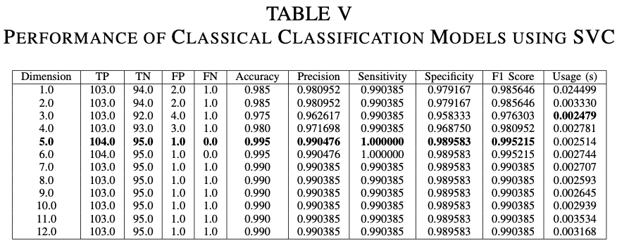
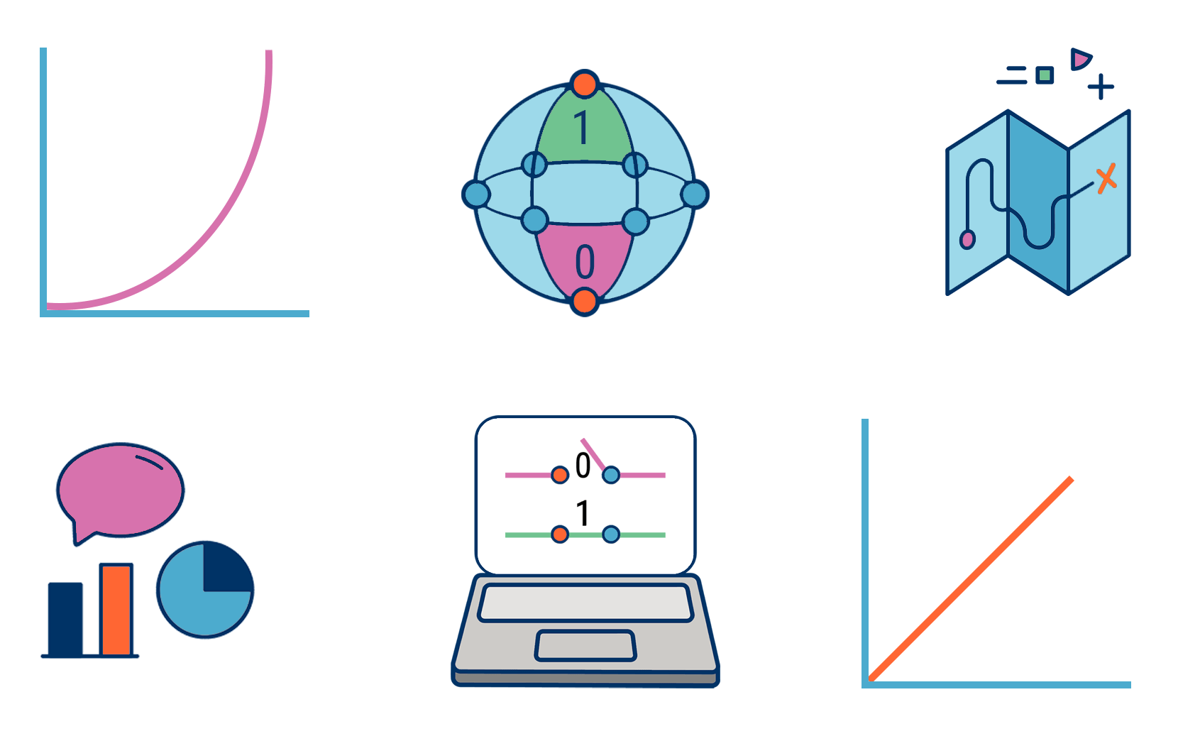
QSVM and SVM Performance

Slide 8
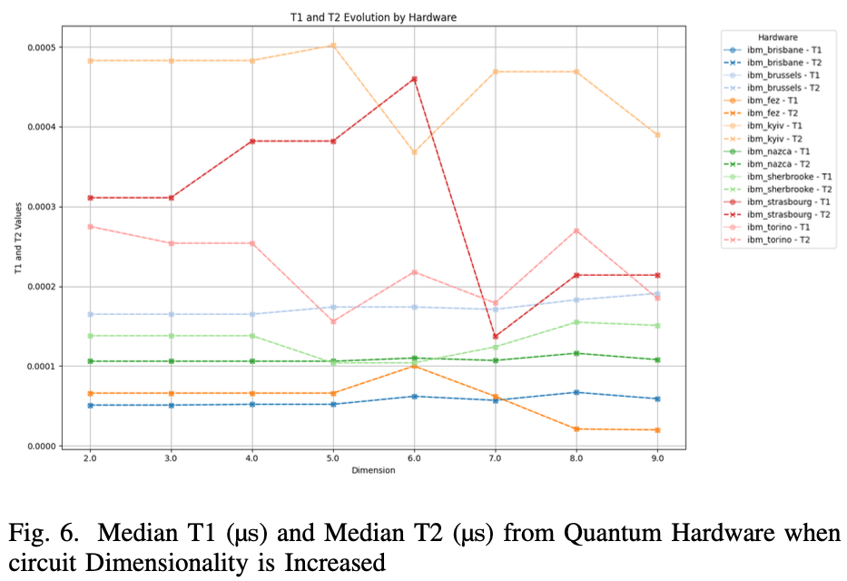
Quantum Backend Characterization
Metrics:
Elapsed time: ↑Exponential growth (2D: 15min → 9D: 240min)
T1/T2 coherence: ibm_brisbane (best for ≤7D), ibm_fez (best for 8-9D)
Readout error: ibm_kyiv/ibm_brisbane (lowest)
Selection Method:
Weighted scoring (T1, T2, readout error) → ibm_brisbane (optimal)

Slide 9
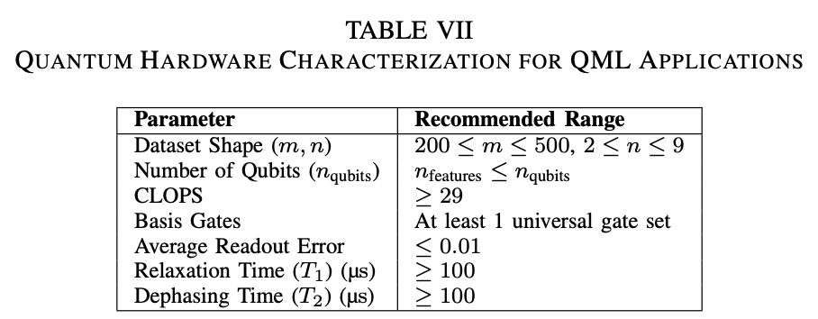
Feasible Hardware Guideline

Slide 10
Conclusion & Future Works
Key Findings:
98.5% accuracy for 2D brain tumor classification (QSVC) → 20% faster than classical SVM.
Performance drop to 44.5% for 9D data → Quantum scalability challenge.
Top backend: ibm_brisbane (low readout error, T_1 : 230µs).
Advantages:
Quantum parallelism enhances low-dimensional data processing.
Correlation-based sub-datasets boost QML efficiency.
Limitations:
Kernel crashes beyond 9D datasets.
Accuracy-time tradeoff for high dimensions.
Future Work:
Hardware: Optimize qubit coherence/error rates for high-dimensional QML.
Algorithms: Develop error-resilient QSVC variants.
Applications: Test on 3D MRI data (e.g., BRATS) for clinical viability.
Notes:
‹#›

Slide 11
Thank you!
Soli Deo Gloria
Sthefanie.Passo@utsa.edu

